Slide 1
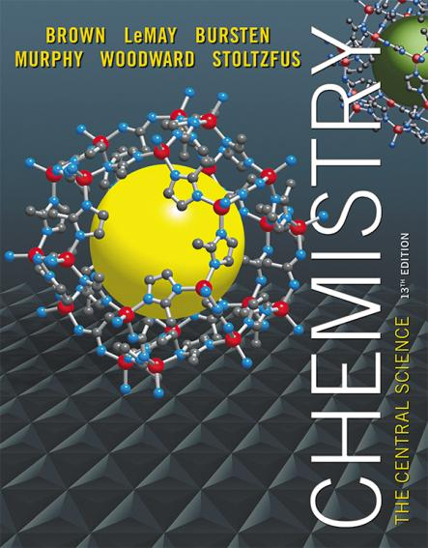
Lecture Presentation
Chapter 21 Nuclear Chemistry

Slide 2
Synopsis of Assigning Oxidation Numbers (as a Reminder)
Elements = 0
Monatomic ion = charge
F: –1
O: –2 (unless peroxide = –1)
H: +1 (unless a metal hydride = –1)
The sum of the oxidation numbers equals the overall charge (0 in a compound).

Slide 3
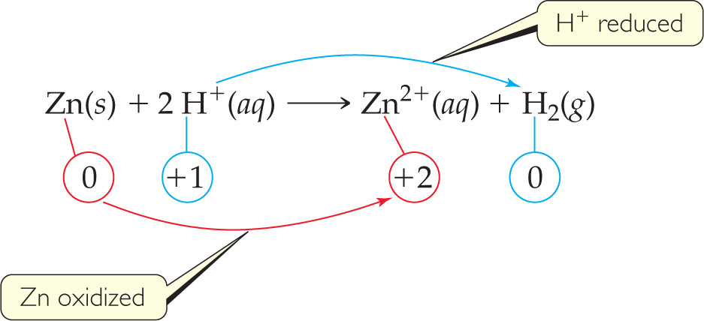
Oxidation and Reduction
A species is oxidized when it loses electrons.
Zinc loses two electrons, forming the Zn²⁺ ion.
A species is reduced when it gains electrons.
H⁺ gains an electron, forming H₂.
An oxidizing agent causes something else to be oxidized (H⁺); a reducing agent causes something else to be reduced (Zn).

Slide 4
Half-Reactions
The oxidation and reduction are written and balanced separately.
We will use them to balance a redox reaction.
For example, when Sn²⁺ and Fe³⁺ react,
Notes:
tin

Slide 5
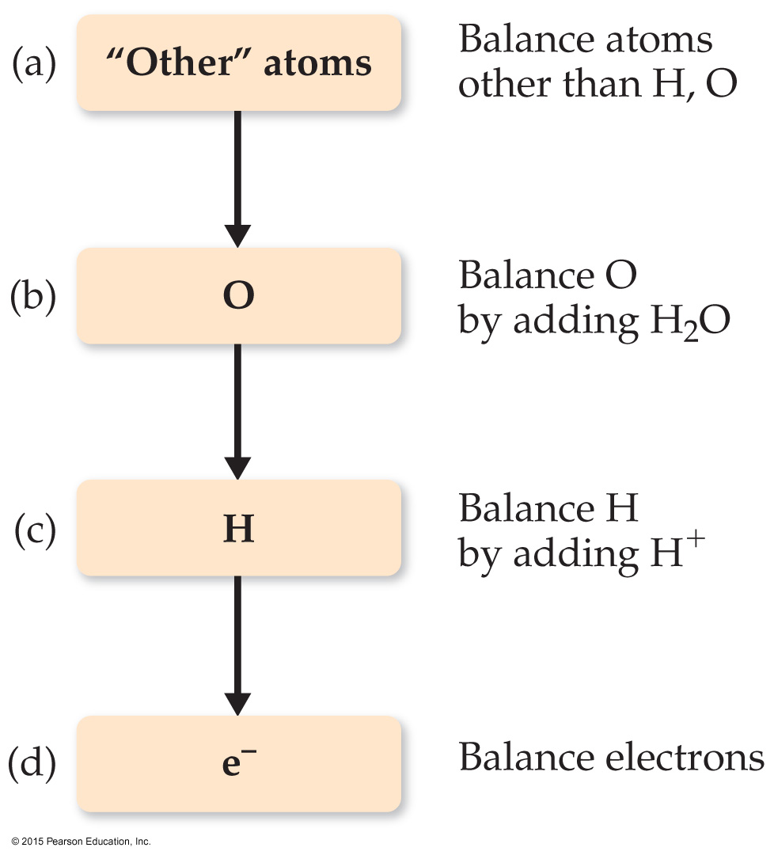
Balancing Redox Equations: The Half-Reactions Method (a Synopsis)
Make two half-reactions (oxidation and reduction).
Balance atoms other than O and H. Then, balance O and H using H₂O/H⁺.
Add electrons to balance charges.
Multiply by common factor to make electrons in half- reactions equal.
Add the half-reactions.
Simplify by dividing by common factor or converting H⁺ to OH– if basic.
Double-check atoms and charges balance!

Slide 6
Combining the Half-Reactions
10e– + 16 H⁺ + 2 MnO₄– + 5 C₂O₄^{2–} ⎯⎯→
2 Mn²⁺ + 8 H₂O + 10 CO₂ +10e–
The only thing that appears on both sides is the electrons. Subtracting them, we are left with
16 H⁺ + 2 MnO₄– + 5 C₂O₄^{2–} ⎯⎯→
2 Mn²⁺ + 8 H₂O + 10 CO₂
(Verify that the equation is balanced by counting atoms and charges on each side of the equation.)

Slide 7
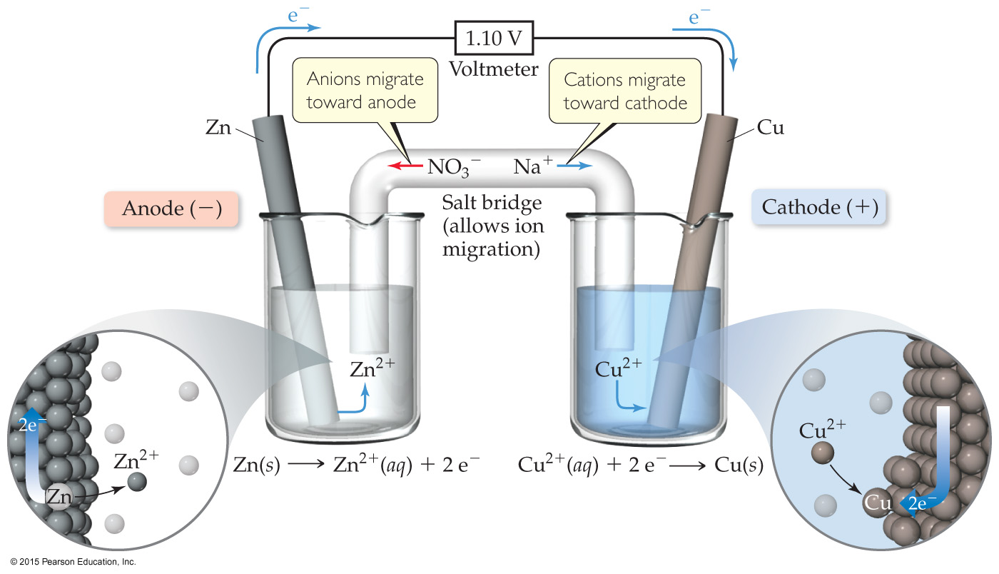
Voltaic Cells
The oxidation occurs at the anode.
The reduction occurs at the cathode.
When electrons flow, charges aren’t balanced. So, a salt bridge, usually a U-shaped tube that contains a salt/agar solution, is used to keep the charges balanced.

Slide 8
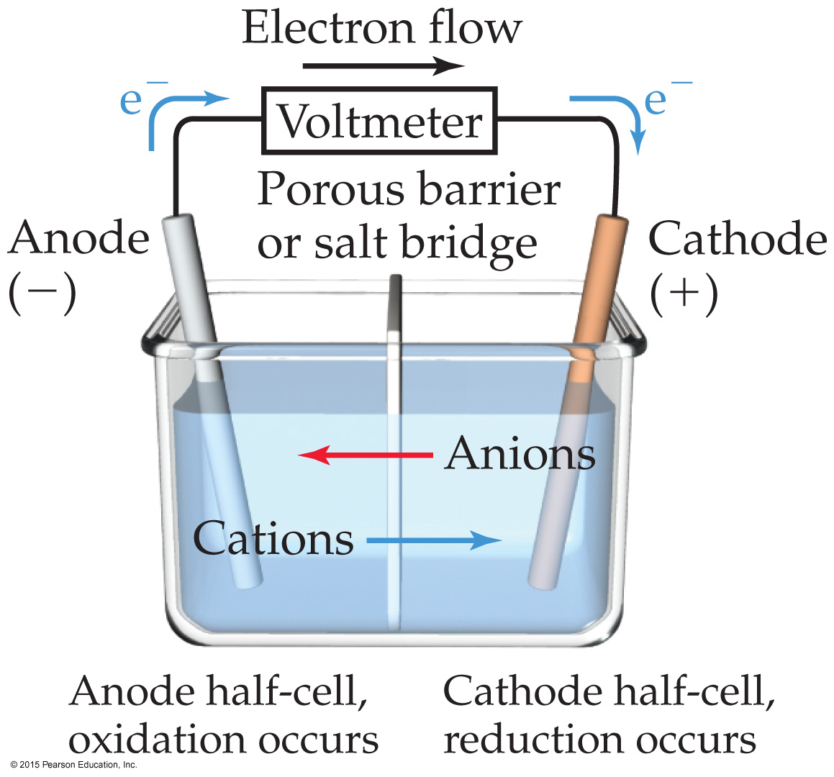
Voltaic Cells
In the cell, electrons leave the anode and flow through the wire to the cathode.
Cations are formed in the anode compartment.
As the electrons reach the cathode, cations in solution are attracted to the now negative cathode.
The cations gain electrons and are deposited as metal on the cathode.

Slide 9
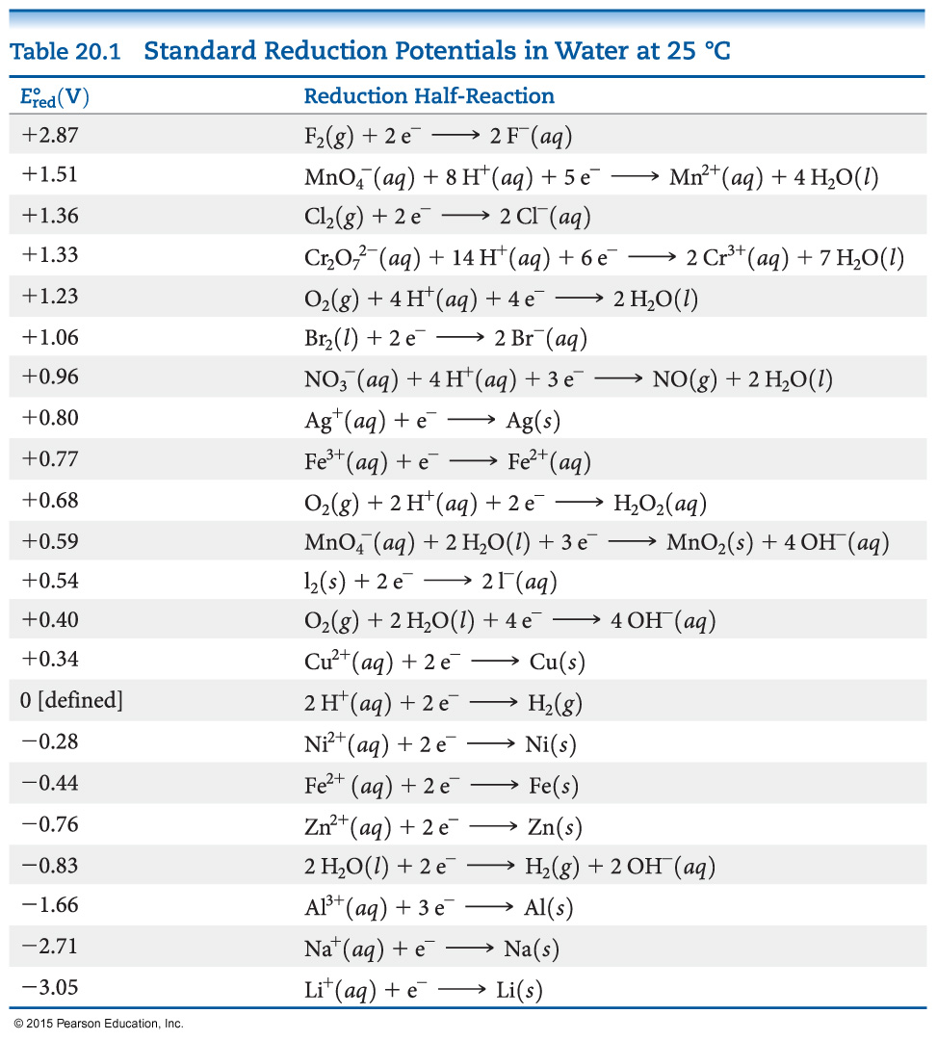
Standard Reduction Potentials
Reduction potentials for many electrodes have been measured and tabulated.
The values are compared to the reduction of hydrogen as a standard.

Slide 10
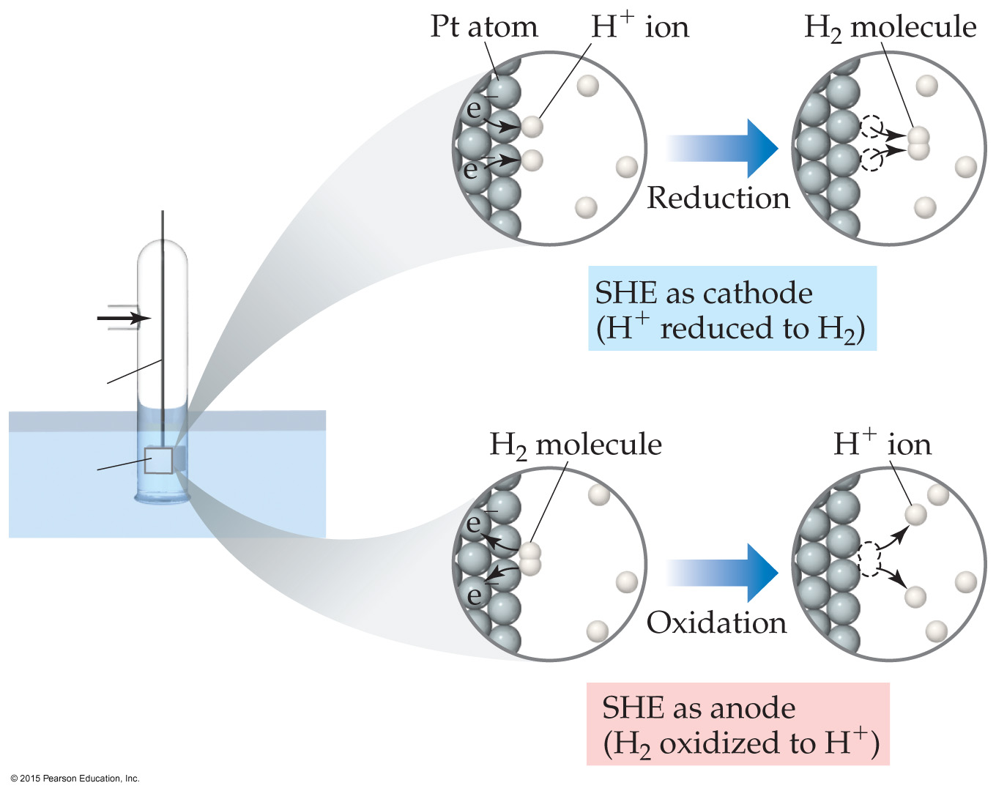
Standard Hydrogen Electrode
Their reference is called the standard hydrogen electrode (SHE).
By definition as the standard, the reduction potential for hydrogen is 0 V:
2 H⁺(aq, 1M) + 2e– ⎯→ H₂(g, 1 atm)

Slide 11
Standard Cell Potentials
The cell potential at standard conditions can be found through this equation:
°
°
°
E_{cell}
= E_{red} (cathode) – E_{red} (anode)
Because cell potential is based on the potential energy per unit of charge, it is an intensive property.
Changing the stoichiometry doesn’t change E_{red}

Slide 12
Cell Potentials
For the anode in this cell, E°_{red} = –0.76 V
For the cathode, E°_{red} = +0.34 V
So, for the cell, E°_{cell} = E°_{red} (cathode) – E°_{red} (anode) = +0.34 V – (–0.76 V) = +1.10 V

Slide 13
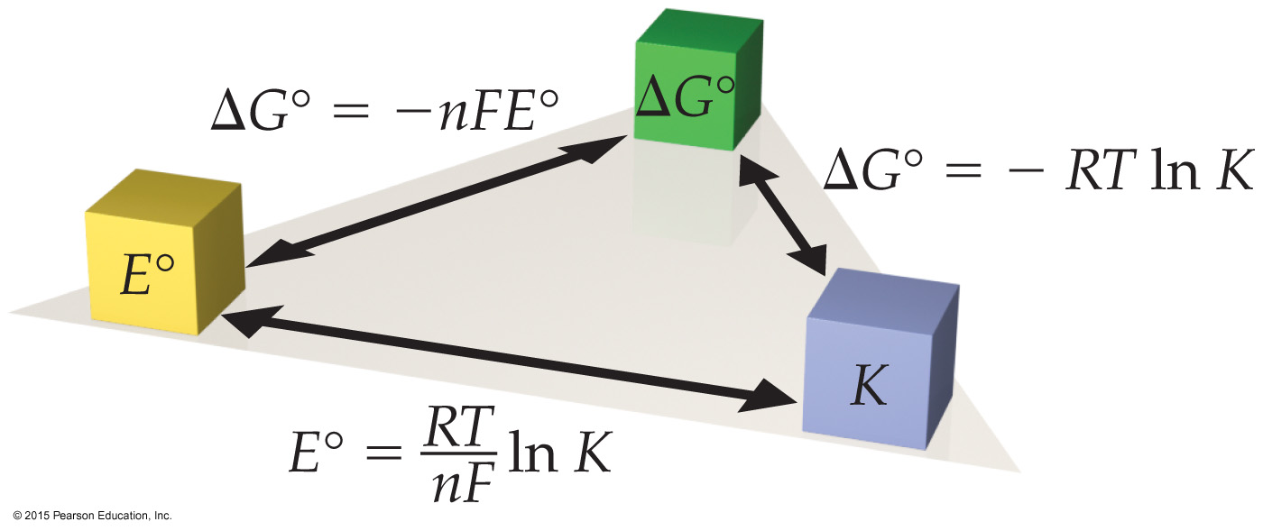
Free Energy, Redox, and K
How is everything related?
ΔG° = –nFE° = –RT ln K

Slide 14
Nernst Equation
Remember, ΔG = ΔG° + RT ln Q
So, –nFE = – nFE° + RT ln Q
Dividing both sides by –nF, we get the Nernst equation:
E = E° – (RT/nF) ln Q
OR E = E° – (2.303 RT/nF) log Q
Using standard thermodynamic temperature and the constants R and F,
E = E° – (0.0592/n) log Q

Slide 15
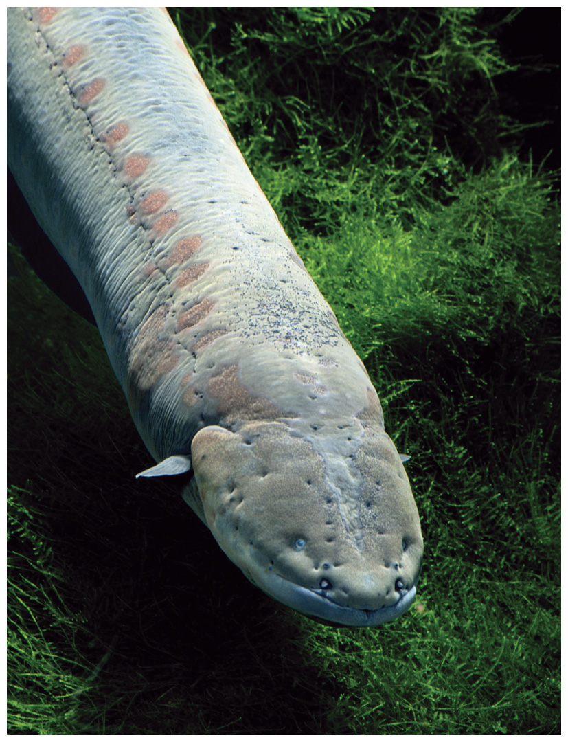
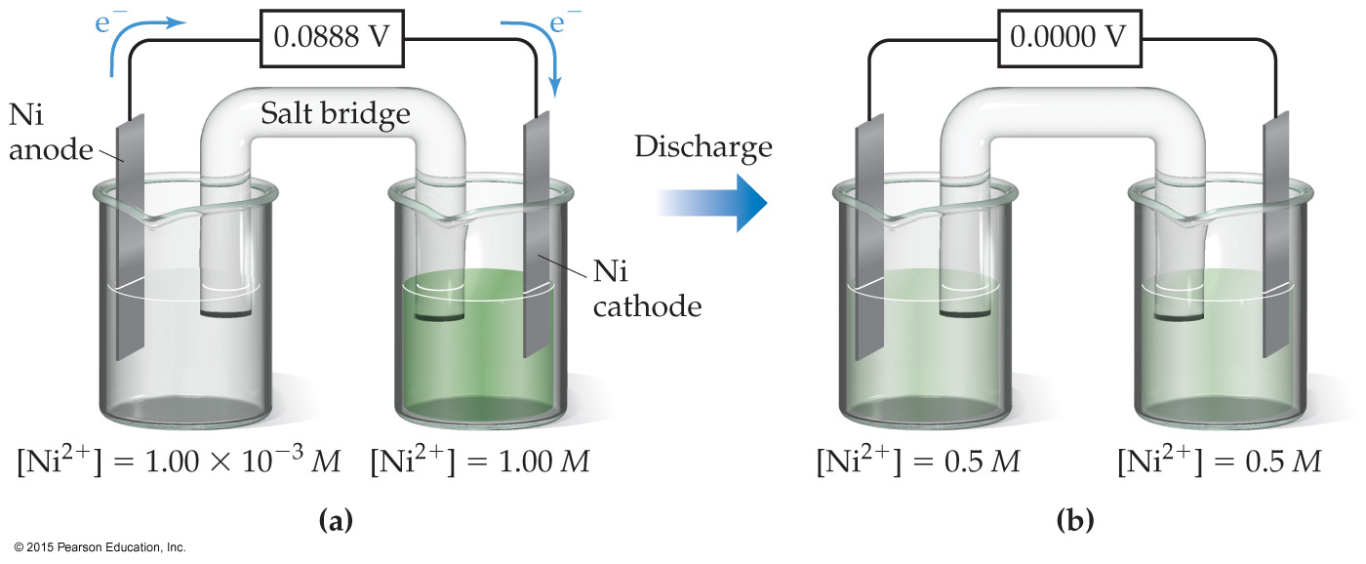
Concentration Cells
Electric eel
Notice that the Nernst equation implies that a cell could be created that has the same substance at both electrodes, called a concentration cell.
E_{cell}
For such a cell,
°
would be 0, but Q would not.
Therefore, as long as the concentrations are different, E will not be 0.
E = E° – (0.0592/n) log Q

Slide 16
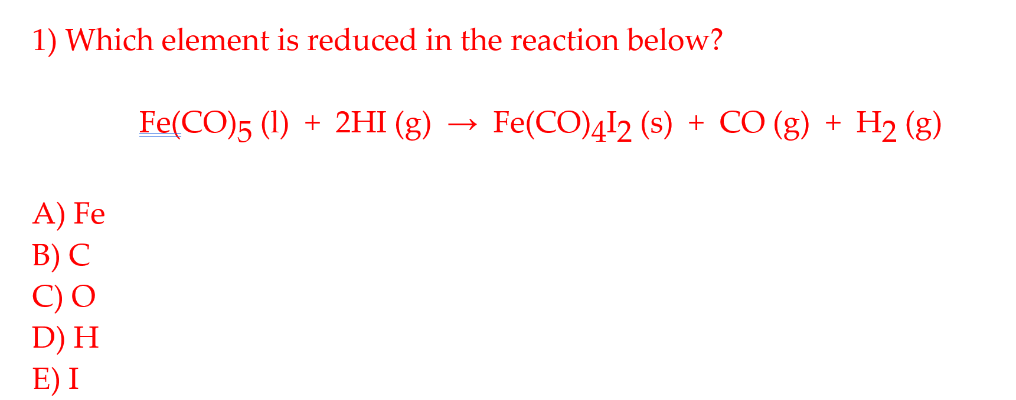
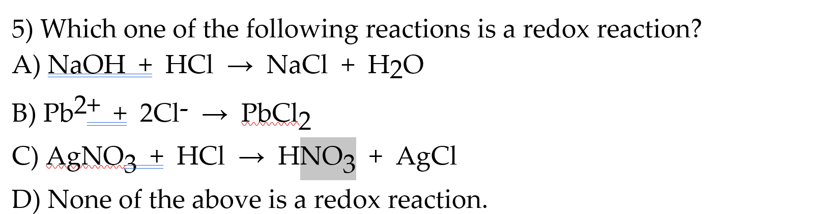

Slide 17
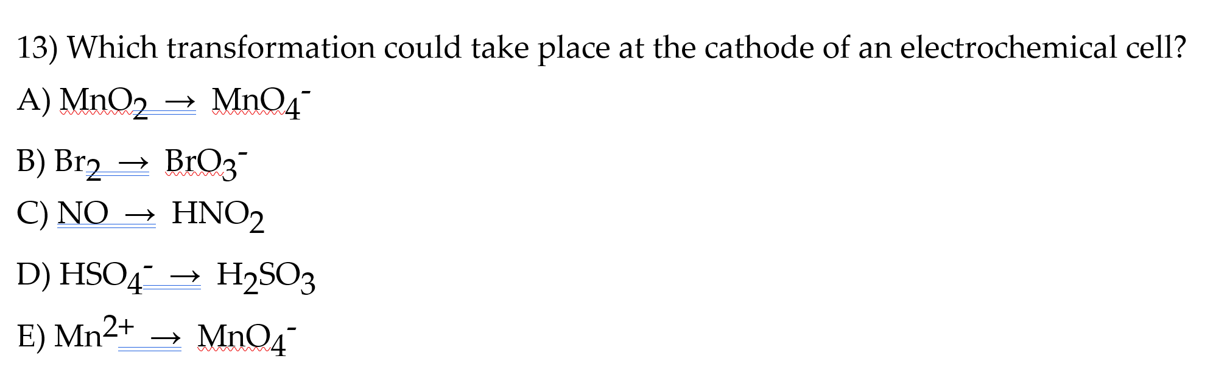
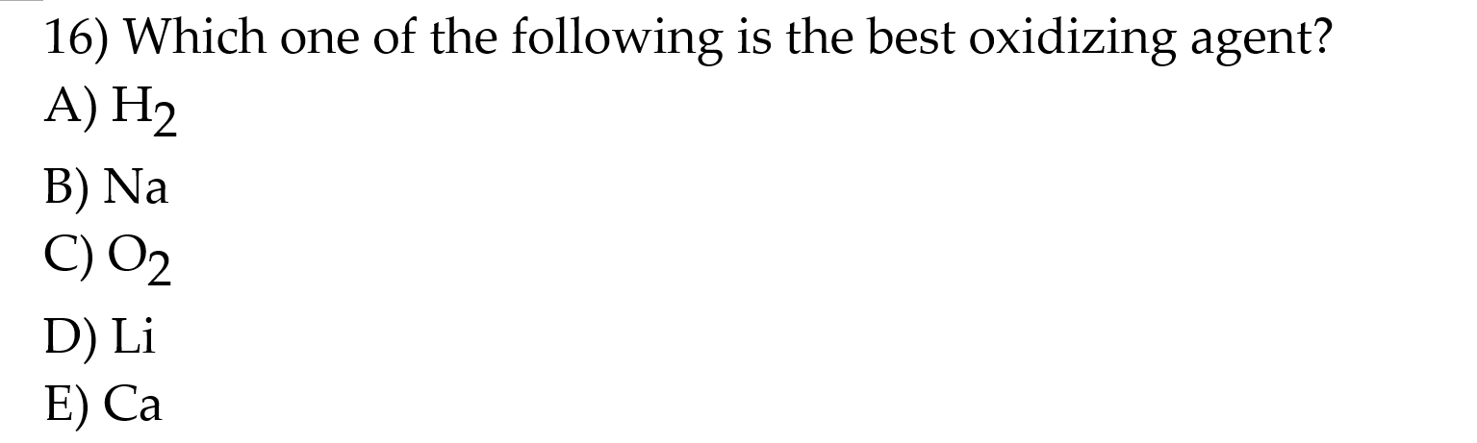

Slide 18
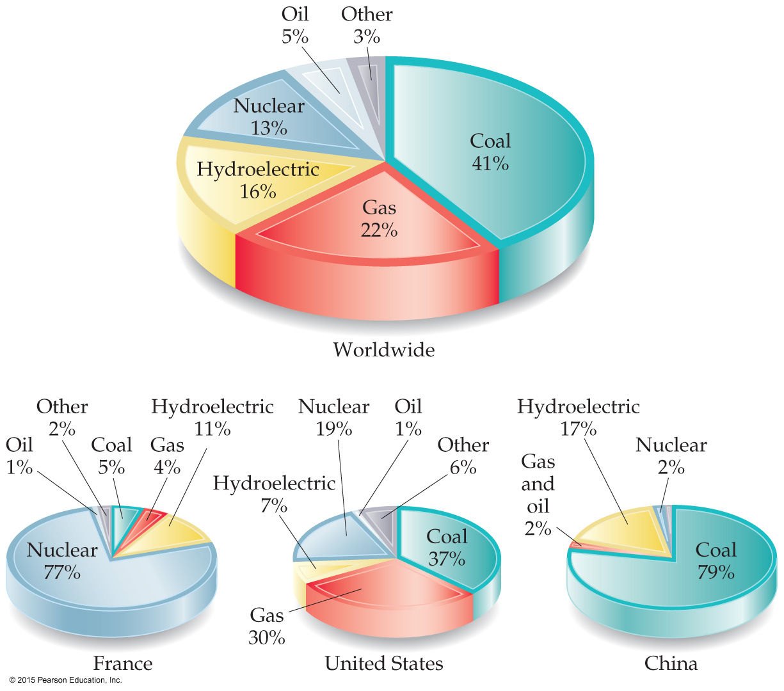
Energy: Chemical vs. Nuclear
Chemical energy is associated with making and breaking chemical bonds.
Nuclear energy is enormous in comparison.
Nuclear energy is due to changes in the nucleus of atoms changing them into different atoms.
13% of worldwide energy use comes from nuclear energy.

Slide 19
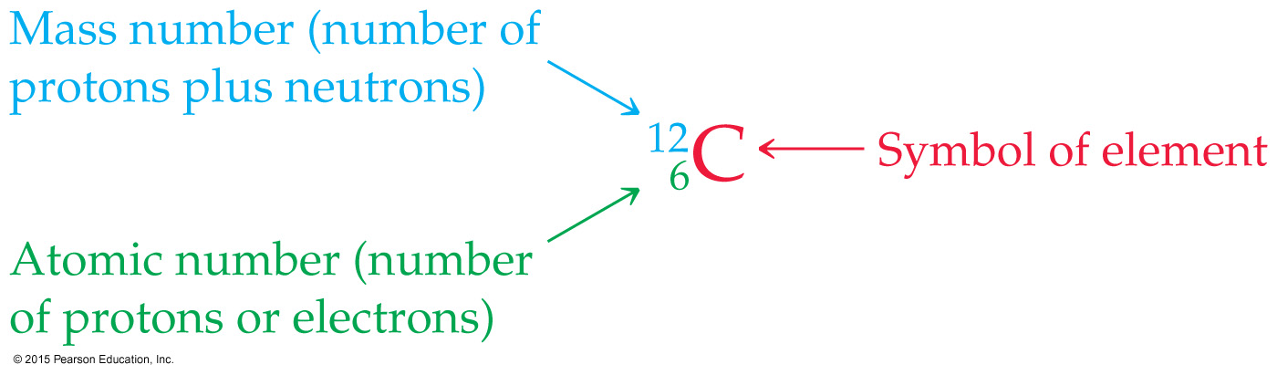
The Nucleus
Remember that the nucleus is composed of the two nucleons （核子）, protons and neutrons.
The number of protons is the atomic number.
The number of protons and neutrons together is the mass number.

Slide 20
Isotopes
Not all atoms of the same element have the same mass, due to different numbers of neutrons in those atoms.
There are, for example, three naturally occurring isotopes of uranium:
Uranium-234
Uranium-235
Uranium-238

Slide 21
Radioactivity
It is not uncommon for some nuclides of an element to be unstable, or radioactive.
We refer to these as radionuclides.
There are several ways radionuclides can decay into a different nuclide.
We use nuclear equations to show how these nuclear reactions occur.

Slide 22
Equations
In chemical equations, atoms and charges need to balance.
In nuclear equations, atomic number and mass number need to balance. This is a way of balancing charge (atomic number) and mass (mass number) on an atomic scale.

Slide 23
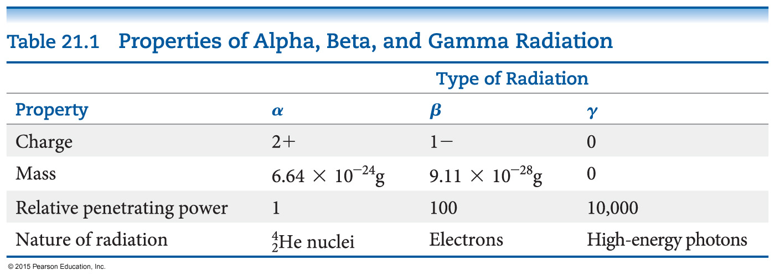
Most Common Kinds of Radiation Emitted by a Radionuclide

Slide 24
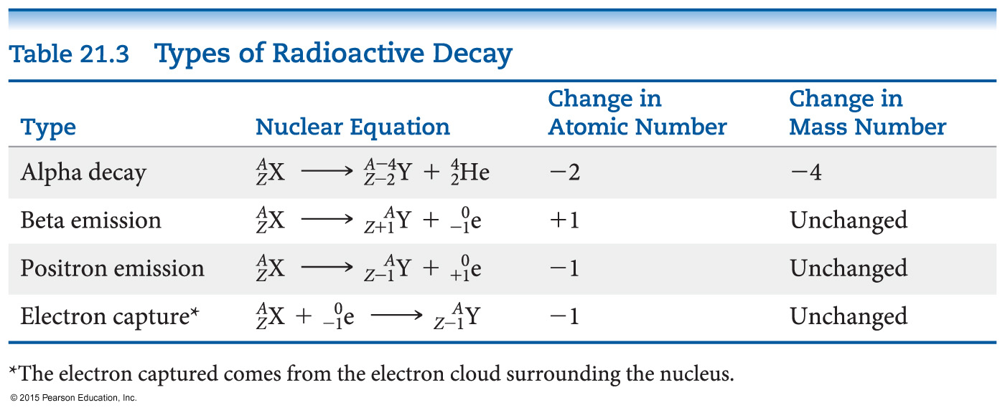
Types of Radioactive Decay
Alpha decay
Beta decay
Gamma emission
Positron emission
Electron capture

Slide 25
Alpha Decay
Alpha decay is the loss of an α-particle (He-4 nucleus, two protons and two neutrons):
4
2
He
238
92
U
234
90
4
2
Th
+
He
⎯⎯→
Note how the equation balances:
atomic number: 92 = 90 + 2
mass number: 238 = 234 + 4
Notes:
thorium

Slide 26
Beta Decay
Beta decay is the loss of a β-particle (a high-speed electron emitted by the nucleus):
0
–1
β
0
–1
e
or
131
53
I
131
54
Xe
+
0
–1
e
⎯⎯→
Balancing: atomic number: 53 = 54 + (–1)
mass number: 131 = 131 + 0

Slide 27
Gamma Emission
Gamma emission is the loss of a γ-ray, which is high-energy radiation that almost always accompanies the loss of a nuclear particle:
γ
0
0

Slide 28
Positron Emission
Some nuclei decay by emitting a positron, a particle that has the same mass as, but an opposite charge to, that of an electron:
0
1
e
11
6
C
11
5
B
0
1
+
e
⎯⎯→
Balancing: atomic number: 6 = 5 + 1
mass number: 11 = 11 + 0

Slide 29
Electron Capture (K-Capture)
An electron from the surrounding electron cloud is absorbed into the nucleus during electron capture.
81
37
Rb
+
0
–1
e
81
36
Kr
⎯⎯→
Balancing: atomic number: 37 + (–1) = 36
mass number: 81 + 0 = 81

Slide 30
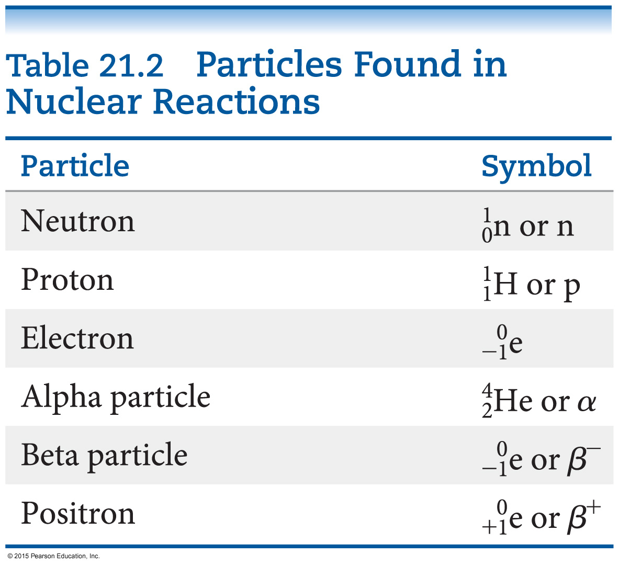
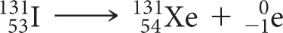

Sources of Some Nuclear Particles
Beta particles:
Positrons:
What happens with electron capture?
Both positron emission and electron capture can convert proton to neutron.

Slide 31
Nuclear Stability
Any atom with more than one proton (anything but H) will have repulsions between the protons in the nucleus.
Strong nuclear force helps keep the nucleus together.
Neutrons play a key role stabilizing the nucleus, so the ratio of neutrons to protons is an important factor.

Slide 32
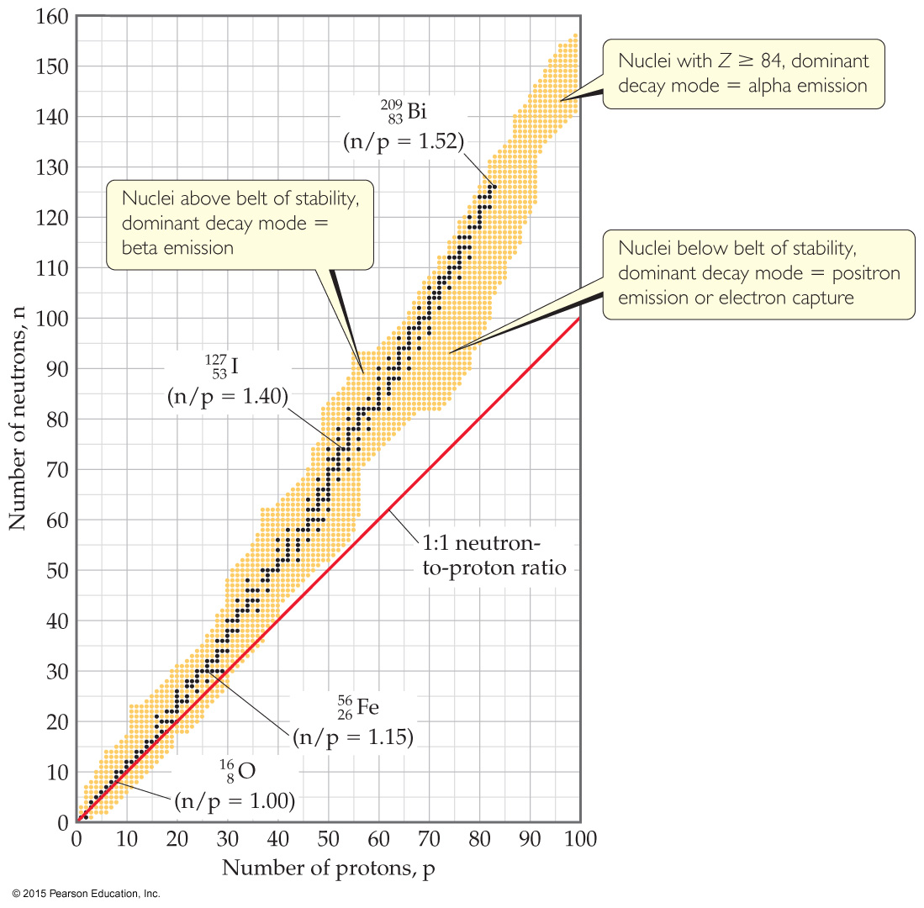
Neutron–Proton Ratios
For smaller nuclei (Z ≤ 20), stable nuclei have a neutron-to-proton ratio close to 1:1.
As nuclei get larger, it takes a larger number of neutrons to stabilize the nucleus.
The shaded region in the figure is called the belt of stability; it shows what nuclides would be stable.

Slide 33
Unstable Nuclei
Compare a nucleus to the “belt of stability.”
Nuclei above this belt have too many neutrons, so they tend to decay by emitting beta particles.
Nuclei below the belt have too many protons, so they tend to become more stable by positron emission or electron capture.

Slide 34
Alpha Emission
There are no stable nuclei with an atomic number greater than 83.
Nuclei with such large atomic numbers tend to decay by alpha emission.

Slide 35
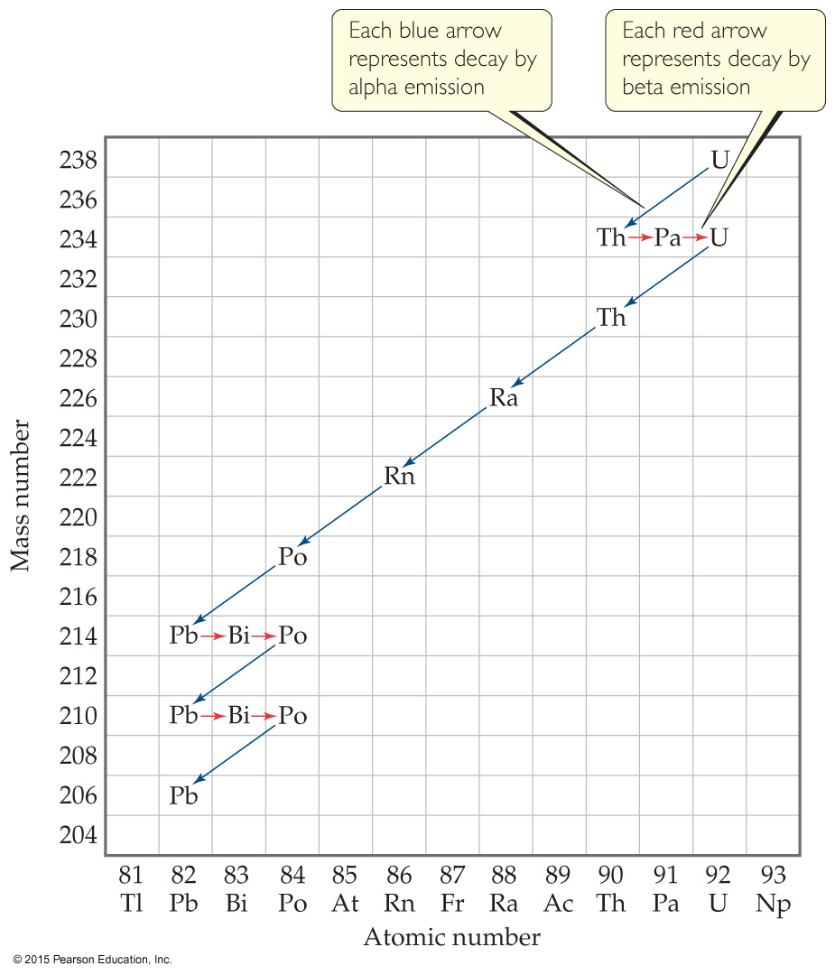
Radioactive Decay Chain
Some radioactive nuclei cannot stabilize by undergoing only one nuclear transformation.
They undergo a series of decays until they form a stable nuclide (often a nuclide of lead).

Slide 36
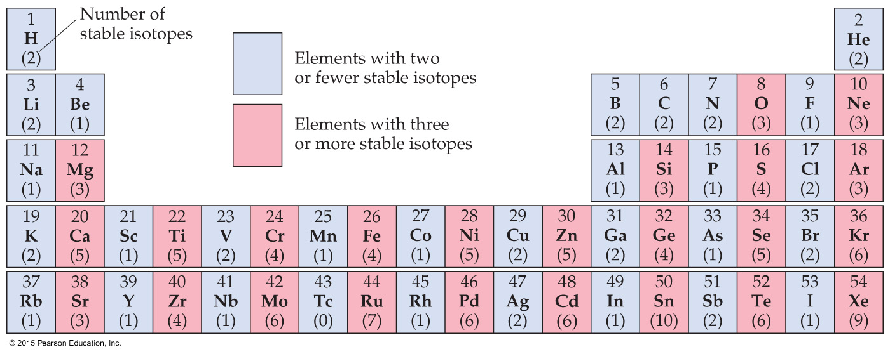
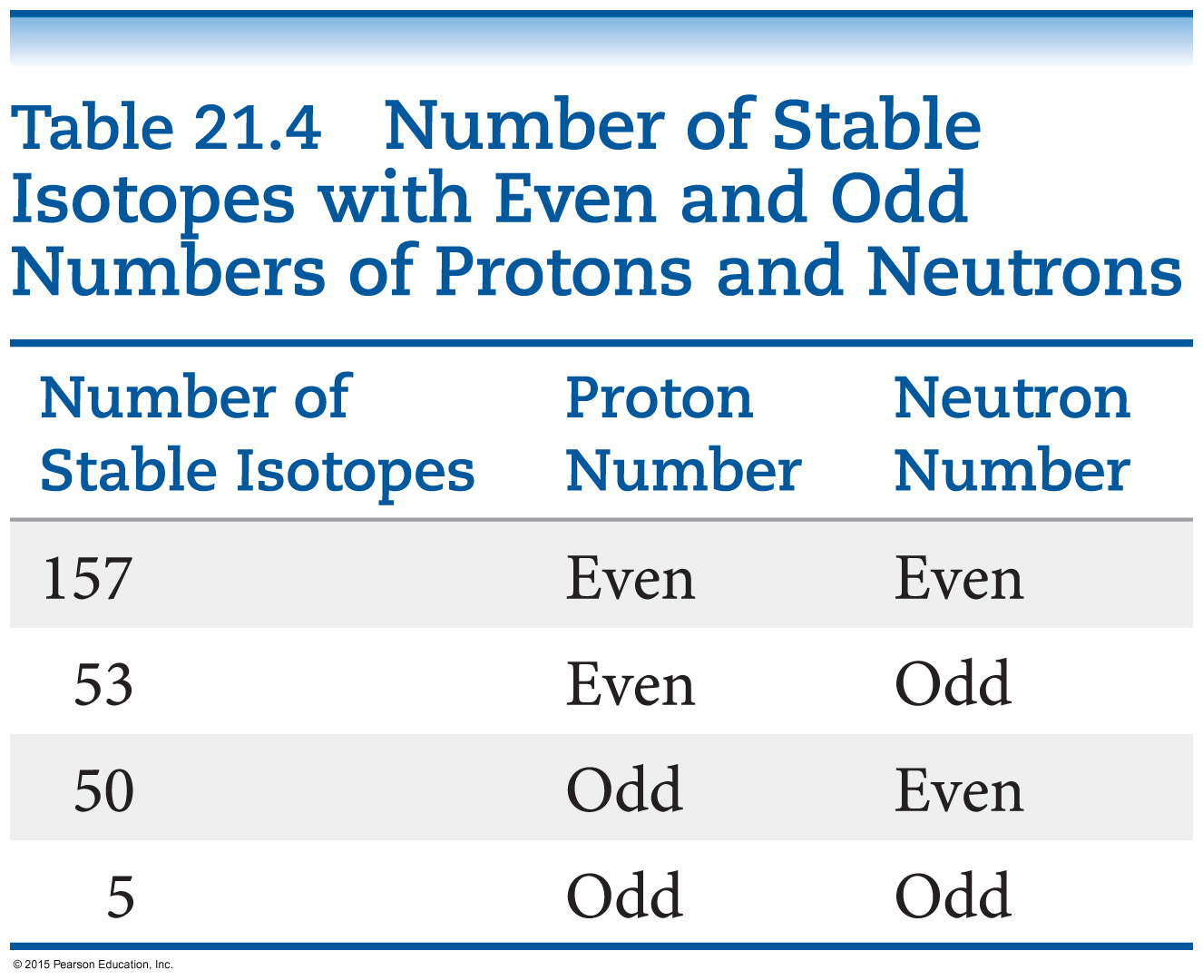
Stable Nuclei
Magic numbers of 2, 8, 20, 28, 50, or 82 protons or 2, 8, 20, 28, 50, 82, or 126 neutrons result in more stable nuclides.
Nuclei with an even number of protons and neutrons tend to be more stable than those with odd numbers.

Slide 37
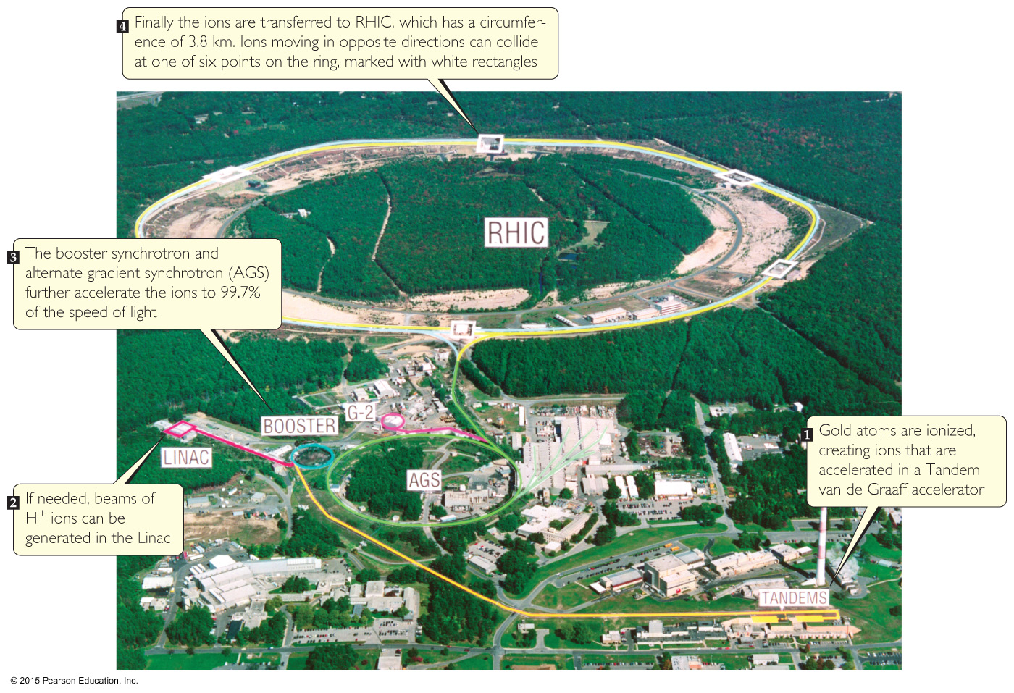
Nuclear Transmutations
Nuclear transmutations can be induced by accelerating a particle to collide it with the nuclide.
Particle accelerators (“atom smashers”) are enormous, having circular tracks with radii that are miles long.

Slide 38
Other Nuclear Transmutations
Use of neutrons:
Most synthetic isotopes used in medicine are prepared by bombarding neutrons at a particle, which won’t repel the neutral particle.
Transuranium elements:
Elements immediately after uranium were discovered by bombarding isotopes with neutrons.
Larger elements (atomic number higher than 110) were made by colliding large atoms with nuclei of light elements with high energy.

Slide 39
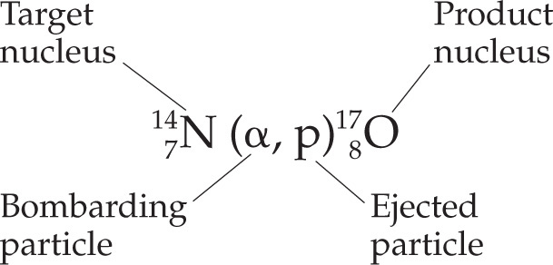
Writing Nuclear Equations for Nuclear Transmutations
Nuclear equations that represent nuclear transmutations are written two ways:
or

Slide 40
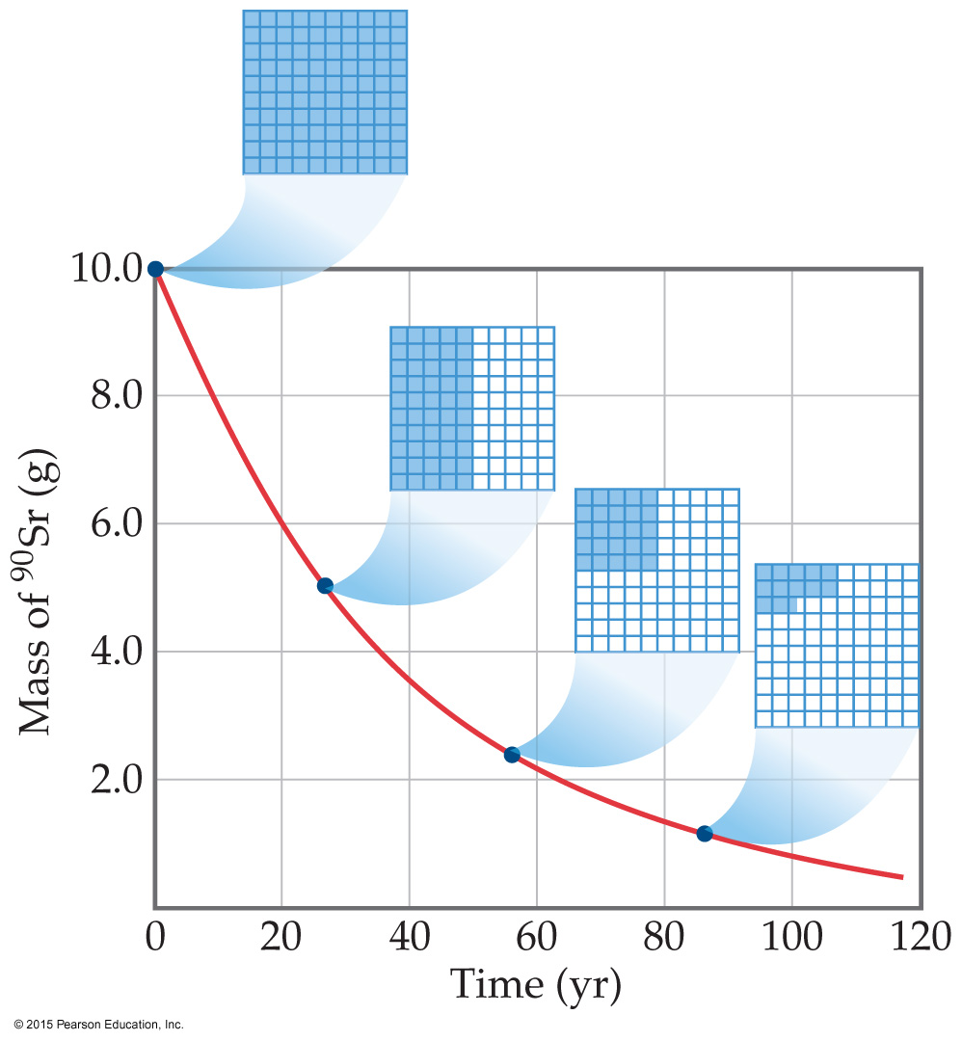
Kinetics of Radioactive Decay
Radioactive decay is a first-order process.
The kinetics of such a process obey this equation:
N_{t}
N₀
ln
= −kt
ln [A] = − k t + ln [A]_{o}

Slide 41
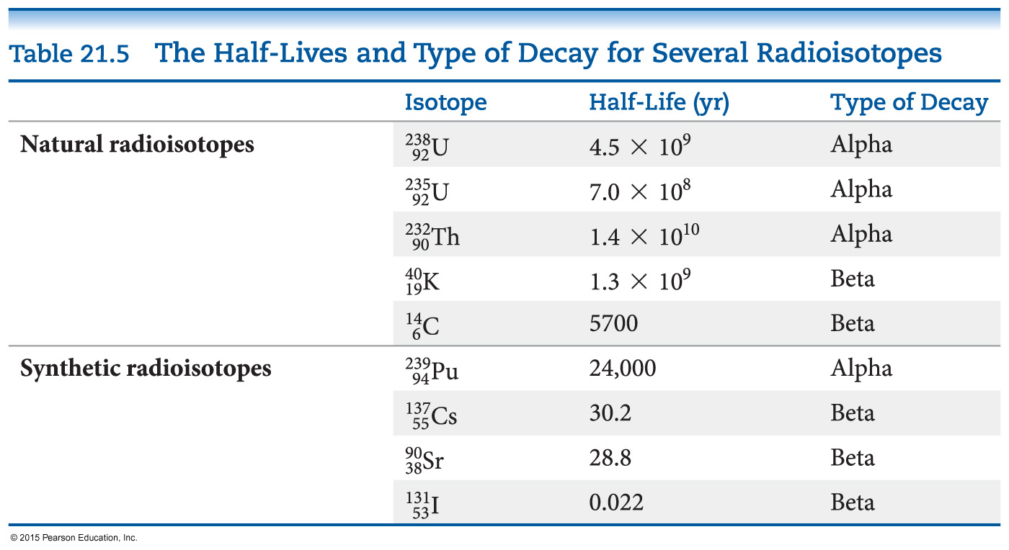
Half-Life
The half-life of such a process is
0.693
k
= t_{1/2}
Half-life is the time required for half of a radionuclide sample to decay.

Slide 42
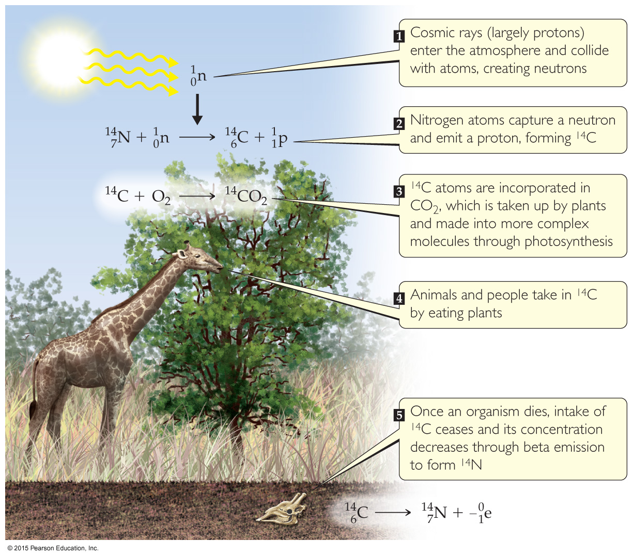
Radiometric Dating
Applying first-order kinetics and half-life information, we can date objects using a “nuclear clock.”
Carbon dating works: the half-life of C-14 is 5700 yr. It is limited to objects up to about 50,000 yr old; after this time there is too little radioactivity left to measure.
Other isotopes can be used (U-238:Pb-206 in rock).
C-14/C-12 = constant

Slide 43
Measuring Radioactivity: Units
Activity is the rate at which a sample decays.
The units used to measure activity are as follows:
Becquerel (Bq): one disintegration per second
Curie (Ci): 3.7 × 10¹⁰ disintegrations per second, which is the rate of decay of 1 g of radium.

Slide 44
Measuring Radioactivity: Some Instruments
Film badges
Geiger counter
Phosphors (scintillation counters)

Slide 45
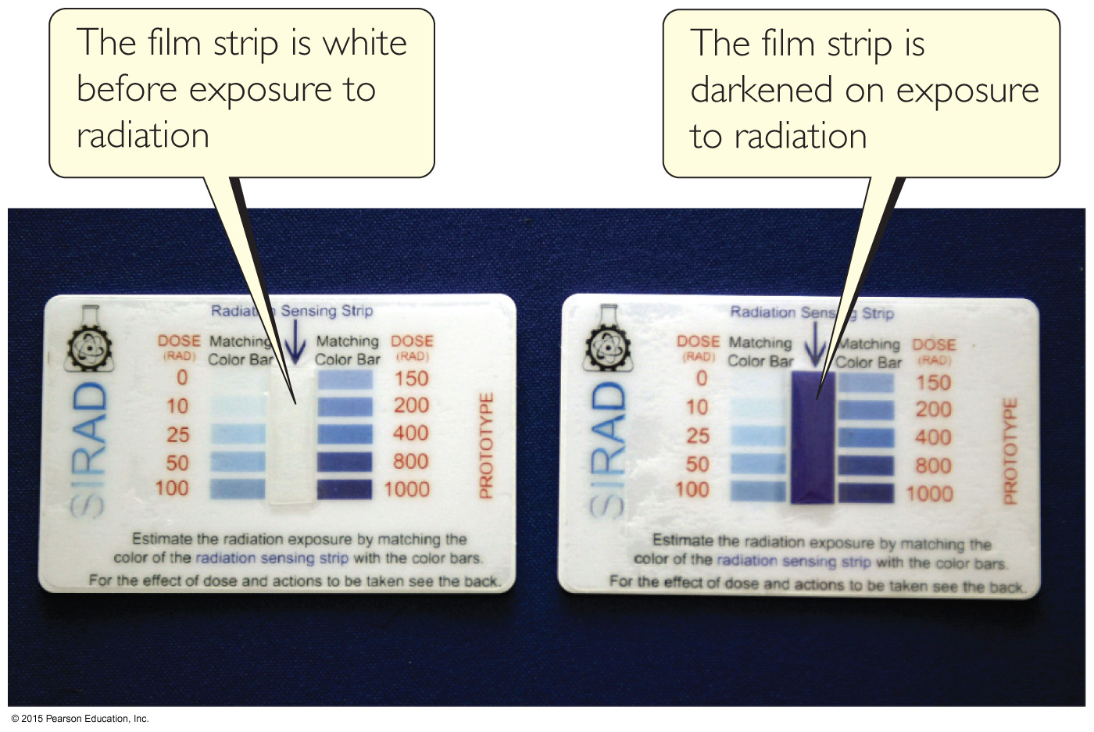
Film Badges
Radioactivity was first discovered by Henri Becquerel because it fogged up a photographic plate.
Film has been used to detect radioactivity since more exposure to radioactivity means darker spots on the developed film.
Film badges are used by people who work with radioactivity to measure their own exposure over time.

Slide 46
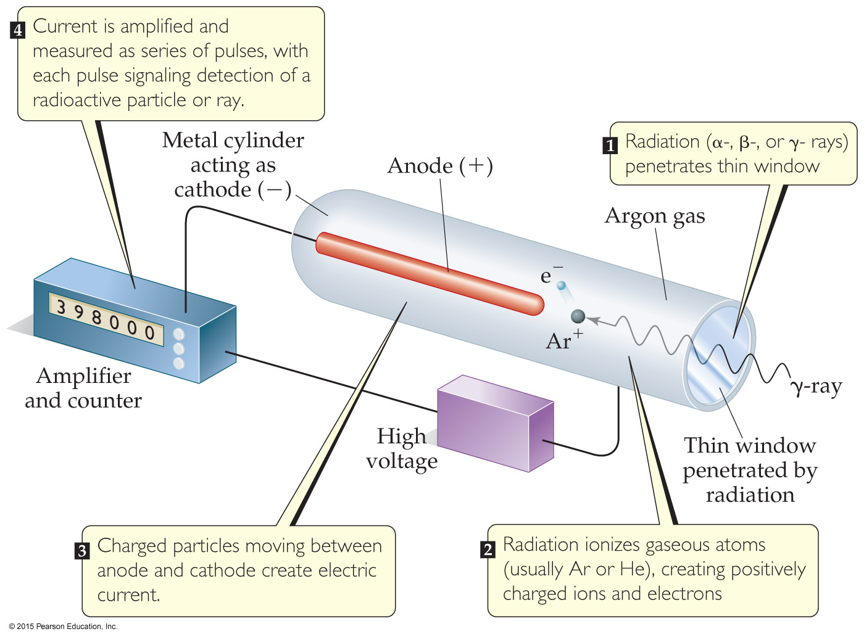
Geiger Counter
A Geiger counter measures the amount of activity present in a radioactive sample.
Radioactivity enters a window and creates ions in a gas; the ions result in an electric current that is measured and recorded by the instrument.

Slide 47
Phosphors
Some substances absorb radioactivity and emit light. They are called phosphors.
An instrument commonly used to measure the amount of light emitted by a phosphor is a scintillation counter. It converts the light to an electronic response for measurement.

Slide 48
Radiotracers
Radiotracers are radioisotopes used to study a chemical reaction.
An element can be followed through a reaction to determine its path and better understand the mechanism of a chemical reaction.

Slide 49
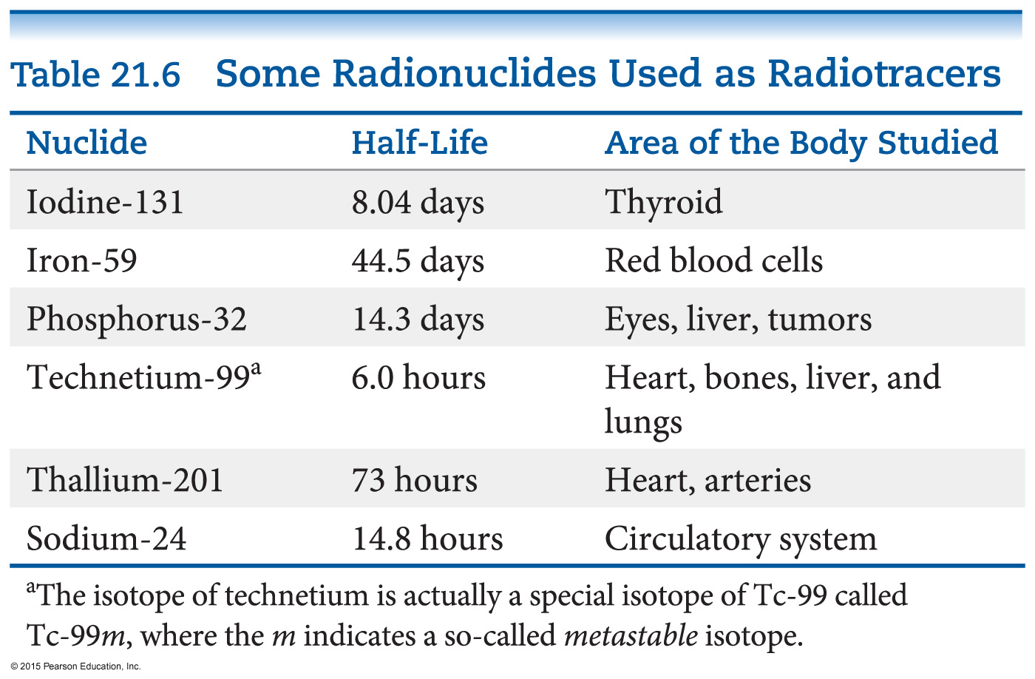
Medical Application of Radiotracers
Radiotracers have found wide diagnostic use in medicine.
Radioisotopes are administered to a patient (usually intravenously) and followed. Certain elements collect more in certain tissues, so an organ or tissue type can be studied based on where the radioactivity collects.

Slide 50
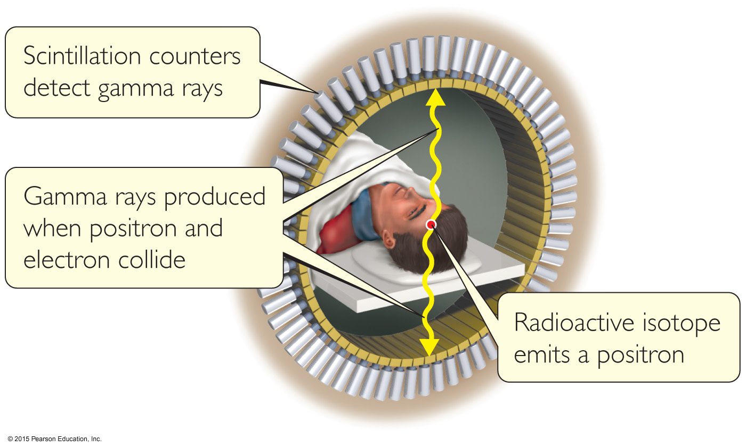
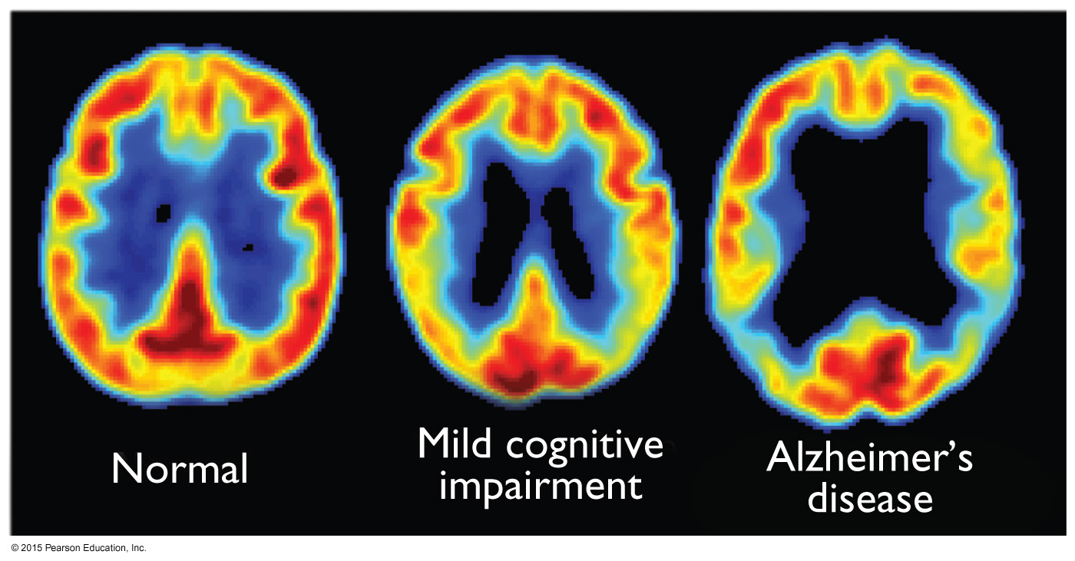
Positron Emission Tomography (PET Scan)
A compound labeled with a positron emitter is injected into a patient.
Blood flow, oxygen and glucose metabolism, and other biological functions can be studied.
Labeled glucose is used to study the brain, as seen in the figure to the right.

Slide 51
Energy in Nuclear Reactions
There is a tremendous amount of energy stored in nuclei.
Einstein’s famous equation, E = mc², relates directly to the calculation of this energy.

Slide 52
Energy in Nuclear Reactions
To show the enormous difference in energy for nuclear reactions, the mass change associated with the α-decay of 1 mol of U-238 to Th-234 is –0.0046 g.
The change in energy, ΔE, is then
ΔE = (Δm)c²
ΔE = (–4.6 × 10^{–6} kg)(3.00 × 10⁸ m/s)²
ΔE = –4.1 × 10¹¹ J
(Note: the negative sign means heat is released.)

Slide 53
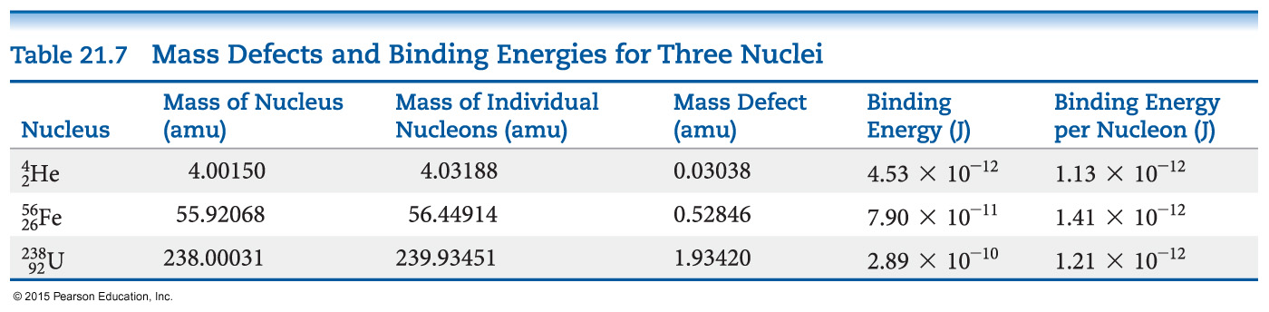
Mass Defect
Where does this energy come from?
The masses of nuclei are always less than those of the individual parts.
This mass difference is called the mass defect.
The energy needed to separate a nucleus into its nucleons is called the nuclear binding energy.

Slide 54
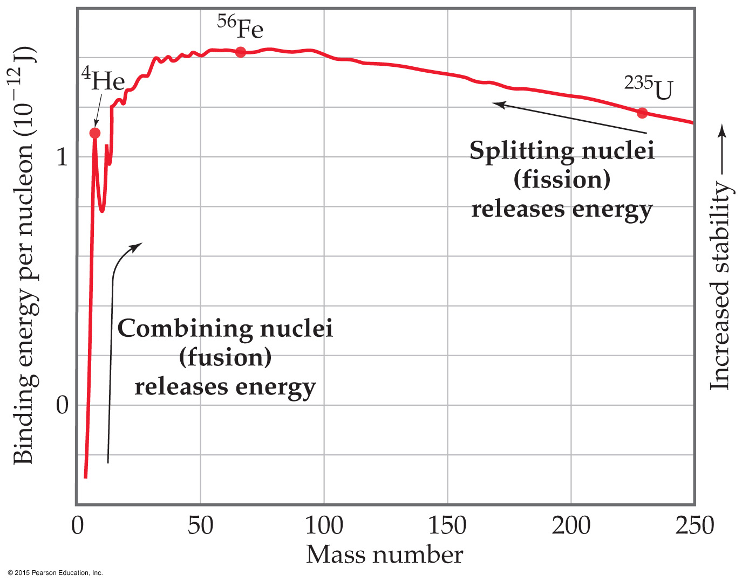
Effects of Nuclear Binding Energy on Nuclear Processes
Dividing the binding energy by the number of nucleons gives a value that can be compared.
Heavy nuclei gain stability and give off energy when they split into two smaller nuclei. This is fission.
Lighter nuclei emit great amounts of energy by being combined in fusion.

Slide 55
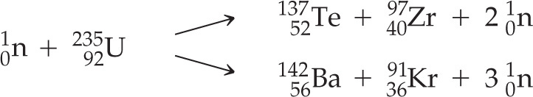
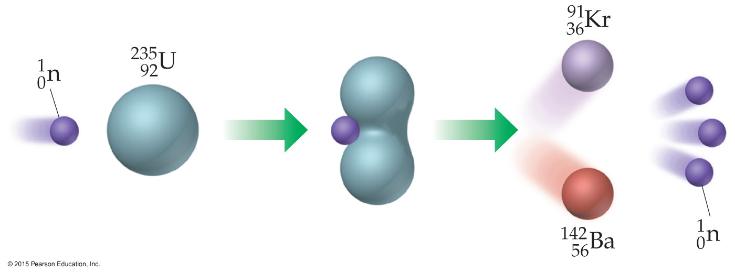
Nuclear Fission
Commercial nuclear power plants use fission.
Heavy nuclei can split in many ways. The equations below show two ways U-235 can split after bombardment with a neutron.

Slide 56
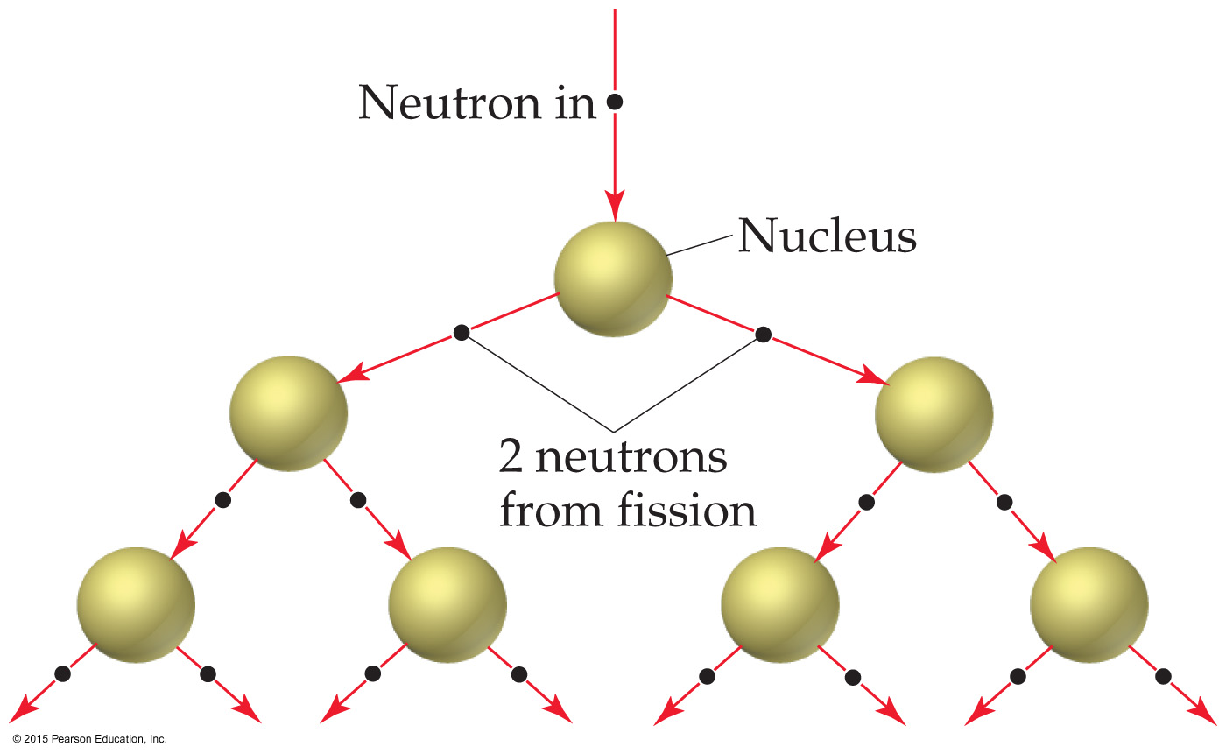
Nuclear Fission
Bombardment of the radioactive nuclide with a neutron starts the process.
Neutrons released in the transmutation strike other nuclei, causing their decay and the production of more neutrons.
This process continues in what we call a nuclear chain reaction.

Slide 57
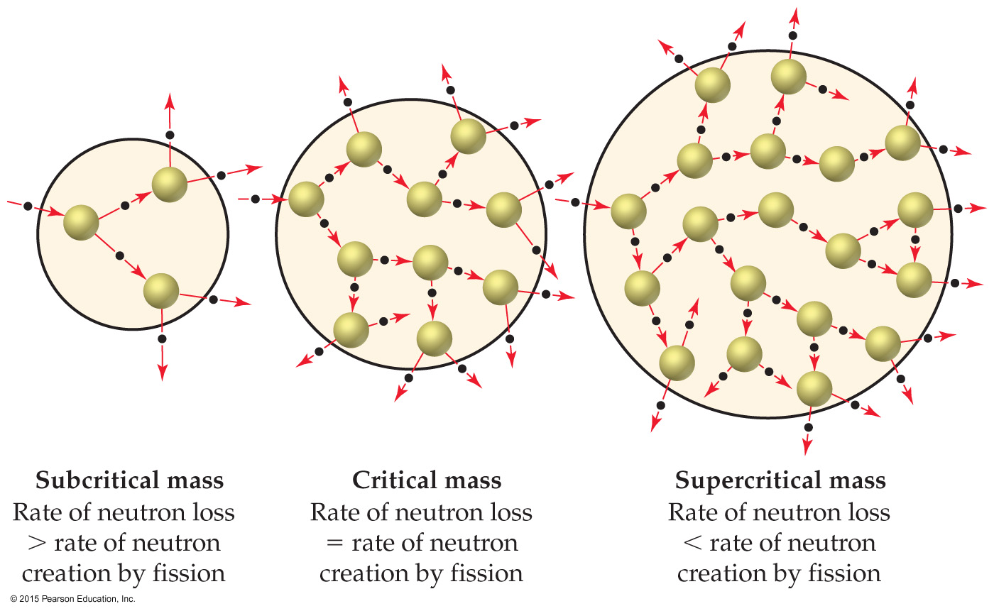
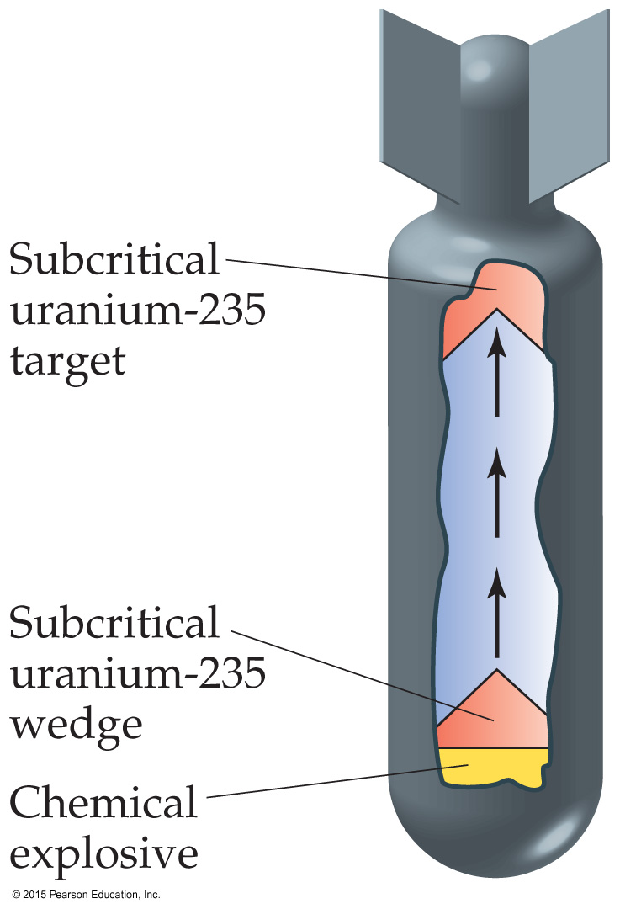
Nuclear Fission
The minimum mass that must be present for a chain reaction to be sustained is called the critical mass.
If more than critical mass is present (supercritical mass), an explosion will occur. Weapons were created by causing smaller amounts to be forced together to create this mass.

Slide 58
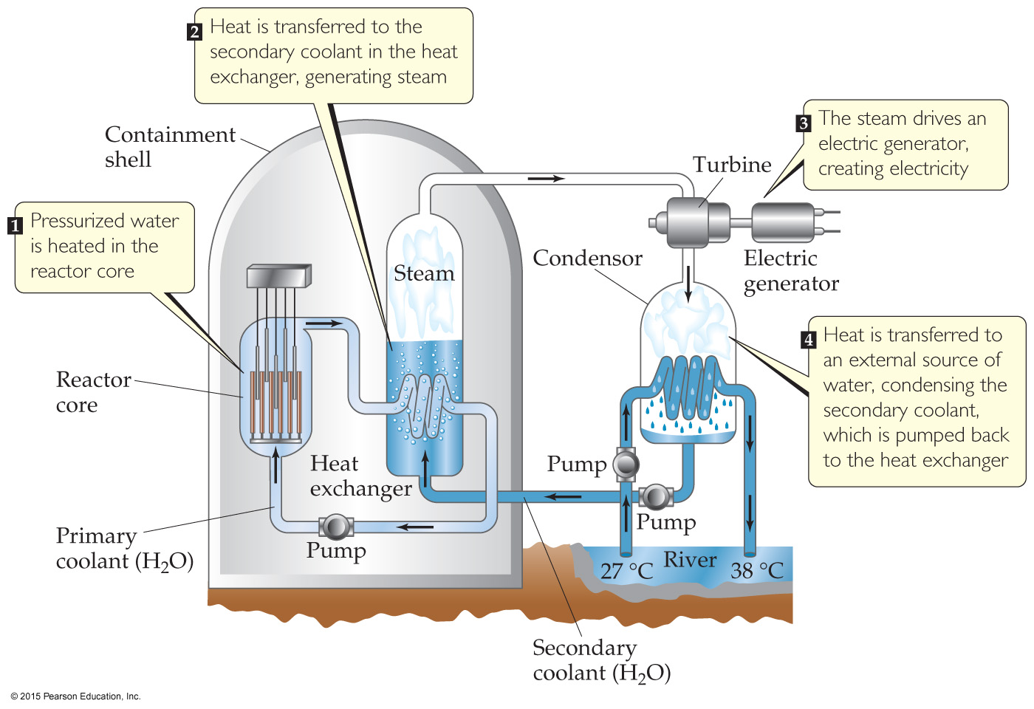
Nuclear Reactors
In nuclear reactors, the heat generated by the reaction is used to produce steam that turns a turbine connected to a generator. Otherwise, the plant is basically the same as any power plant.

Slide 59
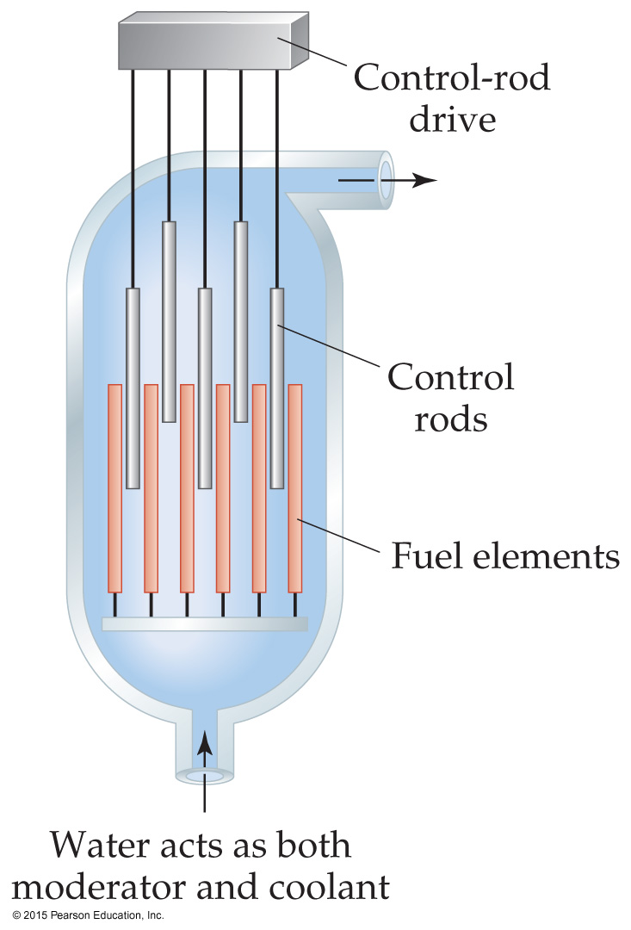
Nuclear Reactors
The reactor core consists of fuel rods, control rods, moderators, and coolant.
The control rods block the paths of some neutrons, keeping the system from reaching a dangerous supercritical mass.

Slide 60
Nuclear Waste
Reactors must be stopped periodically to replace or reprocess the nuclear fuel.
They are stored in pools at the reactor site.
The original intent was that this waste would then be transported to reprocessing or storage sites.
Political opposition to storage site location and safety challenges for reprocessing have led this to be a major social problem.

Slide 61
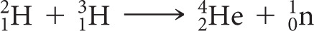
Nuclear Fusion
When small atoms are combined, much energy is released.
If it were possible to easily produce energy by this method, it would be a preferred source of energy.
However, extremely high temperatures and pressures are needed to cause nuclei to fuse.
This was achieved using an atomic bomb to initiate fusion in a hydrogen bomb. Obviously, this is not an acceptable approach to producing energy.

Slide 62
Radiation in the Environment
We are constantly exposed to radiation.
Ionizing radiation is more harmful to living systems than nonionizing radiation, such as radiofrequency electromagnetic radiation.
Since most living tissue is ~70% water, ionizing radiation is that which causes water to ionize.
This creates unstable, very reactive OH radicals, which result in much cell damage.

Slide 63
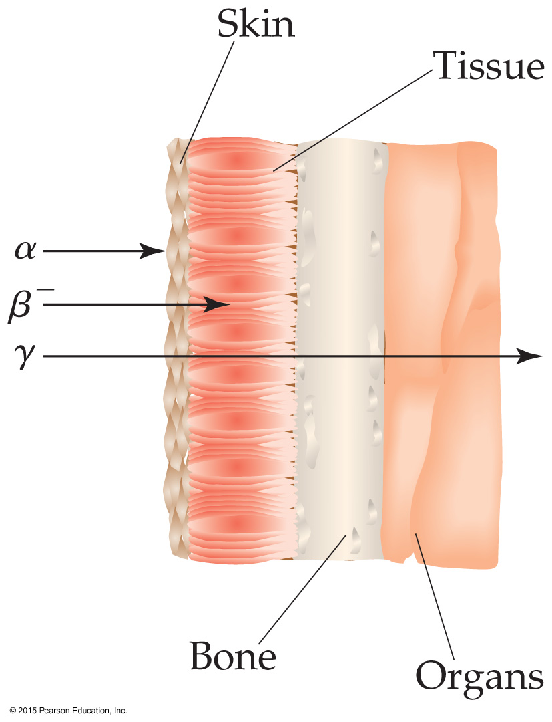
Damage to Cells
The damage to cells depends on the type of radioactivity, the length of exposure, and whether the source is inside or outside the body.
Outside the body, gamma rays are most dangerous.
Inside the body, alpha radiation can cause most harm.

Slide 64
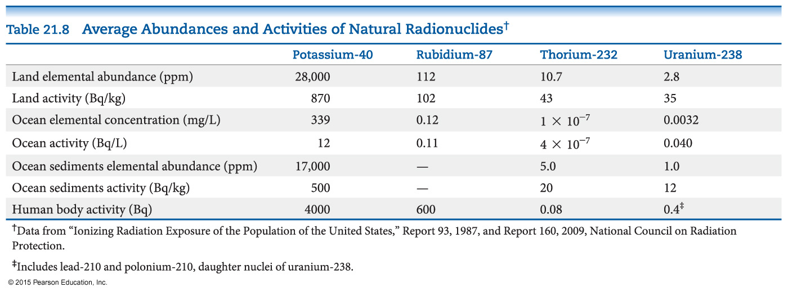
Exposure
We are constantly exposed to radiation. What amount is safe?
Setting standards for safety is difficult.
Low-level, long-term exposure can cause health issues.
Damage to the growth-regulation mechanism of cells results in cancer.

Slide 65
Radiation Dose
Two units are commonly used to measure exposure to radiation:
Gray (Gy): absorption of 1 J of energy per kg of tissue
Rad (for radiation absorbed dose): absorption of 0.01 J of energy per kg of tissue (100 rad = 1 Gy)
Not all forms of radiation harm tissue equally. A relative biological effectiveness (RBE) is used to show how much biological effect there is.
The effective dose is called the rem (SI unit Sievert; 1 Sv = 100 rem)
# of rem = (# of rad) (RBE)

Slide 66
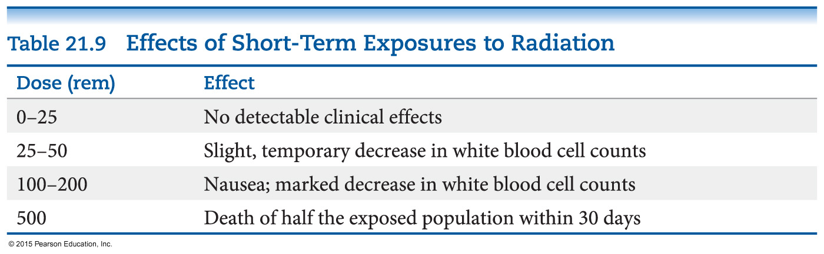
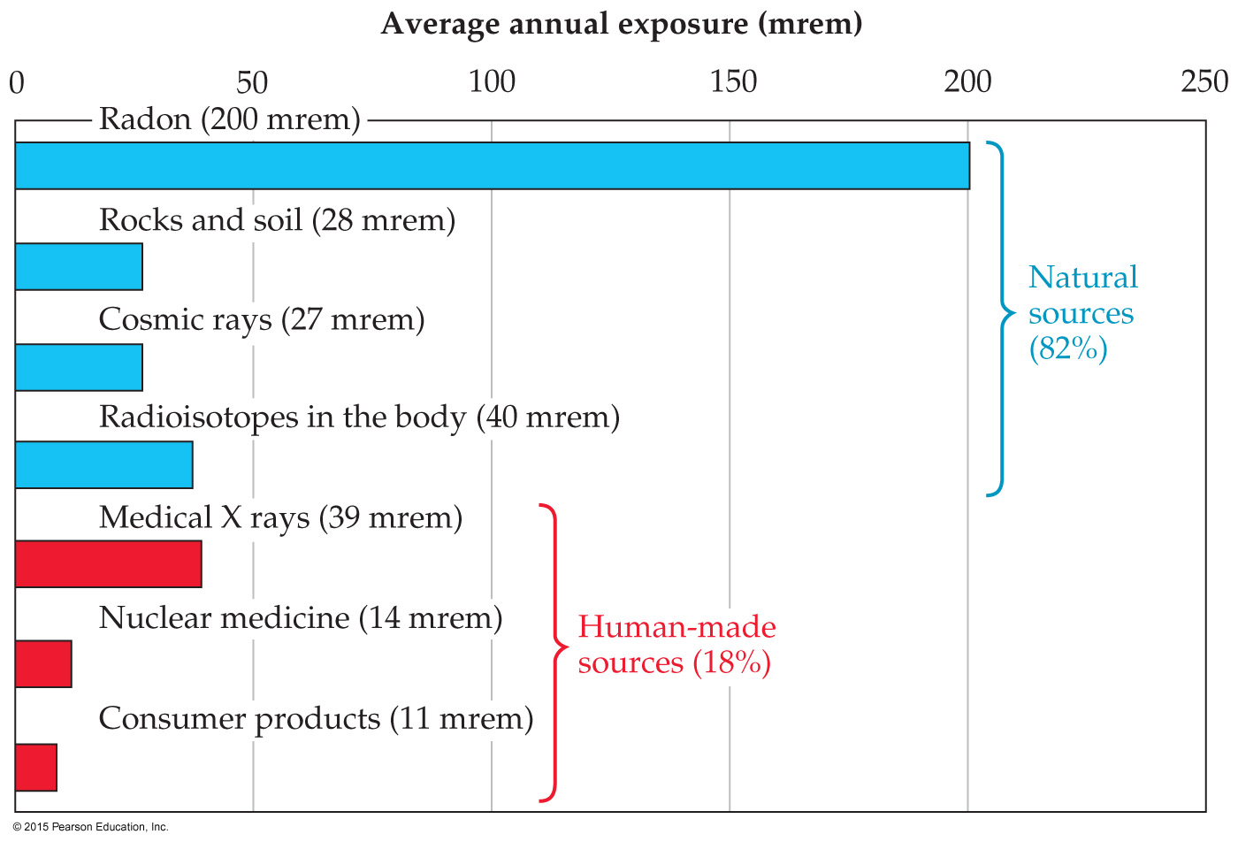
Short-Term Exposure
600 rem is fatal to most humans.
Average exposure per year is about 360 mrem.

Slide 67
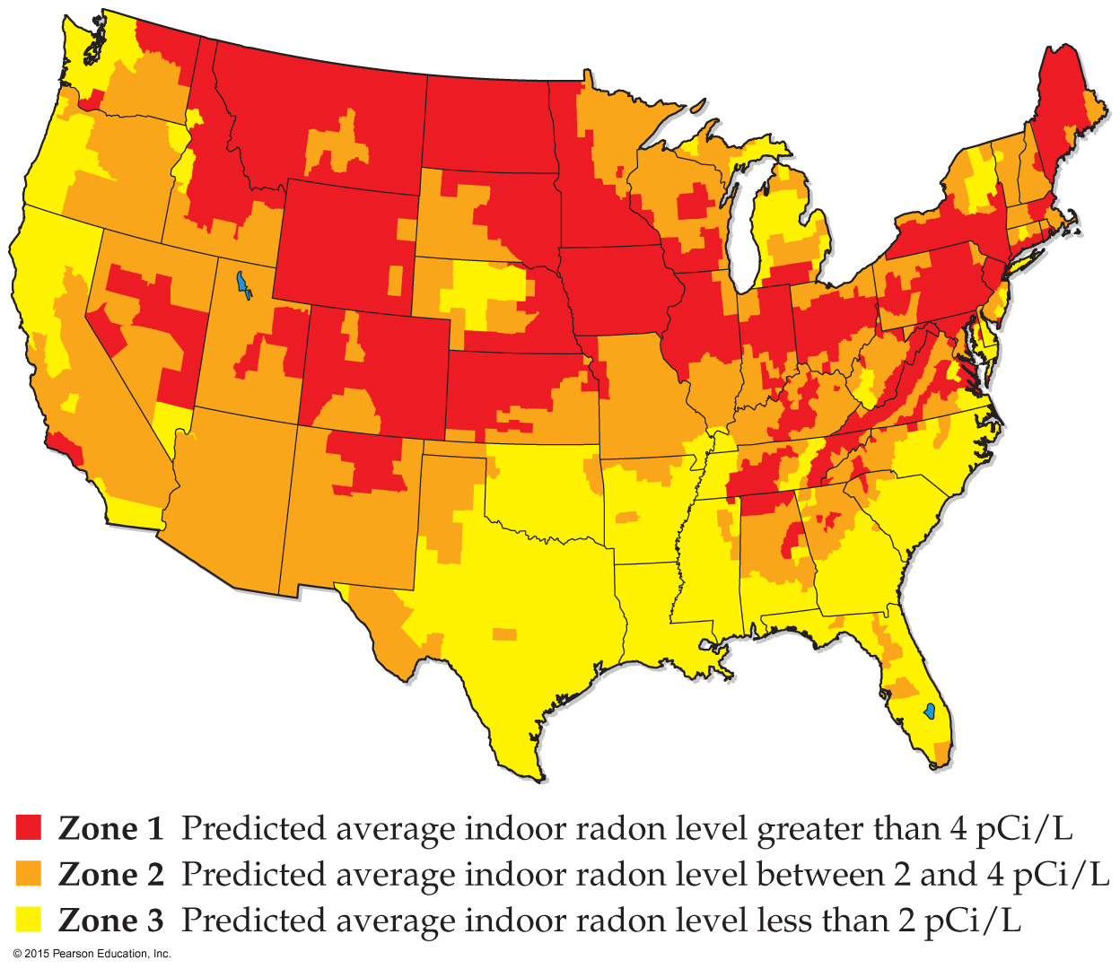
Radon
Radon-222 is a decay product of uranium-238, which is found in rock formations and soil.
Most of the decay products of uranium remain in the soil, but radon is a gas.
When breathed in, it can cause much harm, since it produces alpha particles, which have a high RBE.
It is estimated to contribute to 10% of all lung cancer deaths in the United States.

